Slide 1
Celebrating Black Lives Exploring African-American Firsts
Group 10
Brigita, Deniz, Lujia, Marco, Martino, Noor
Notes:
PURPOSE of our work → Problems and Questions we analyse

Slide 2
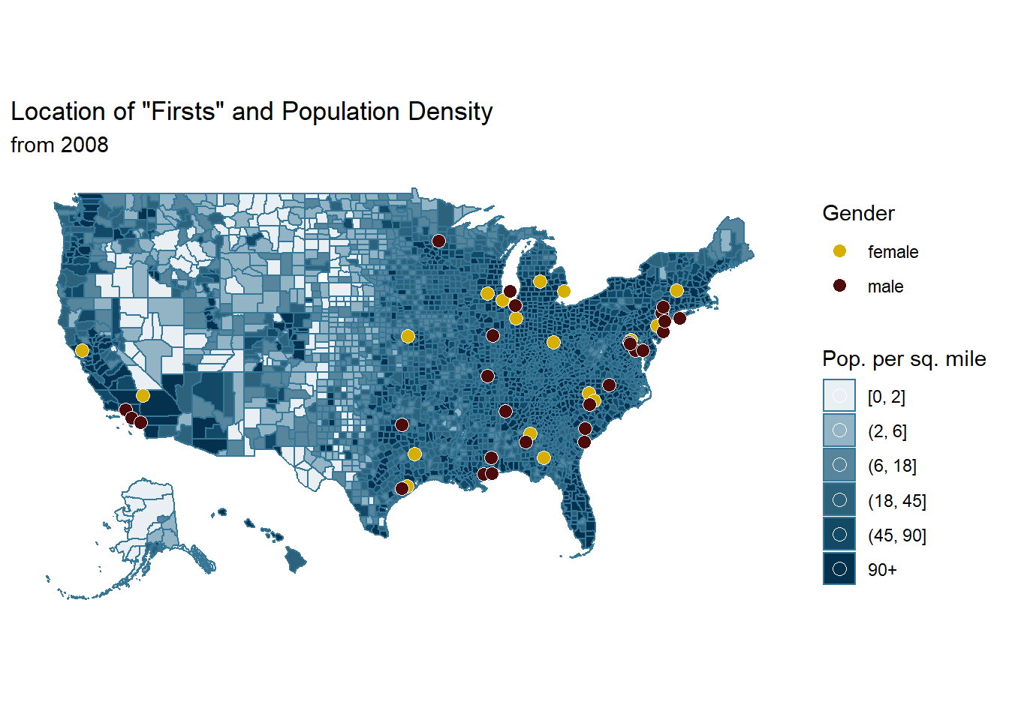
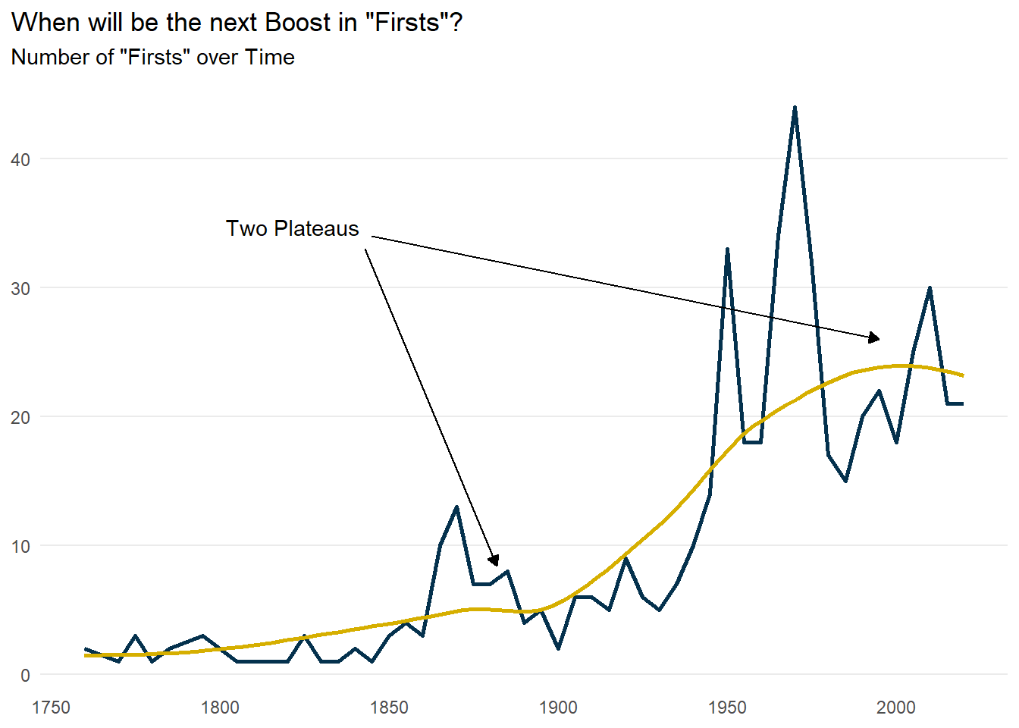
From scraped Data to insightful Visualizations
Two-step approach in creating visualizations
1
2
Data Scraping & Wrangling
EDA & Visualizations
Data Source: Wikipedia
Data Source: Wikipedia
Research: African-American History
African American Firsts
Individual Demographic Information
Clean Data
Enriching Data by Adding Location & Gender
Clean Data & Add Shape Files
EDA
Notes:
PREPARATION

Slide 3
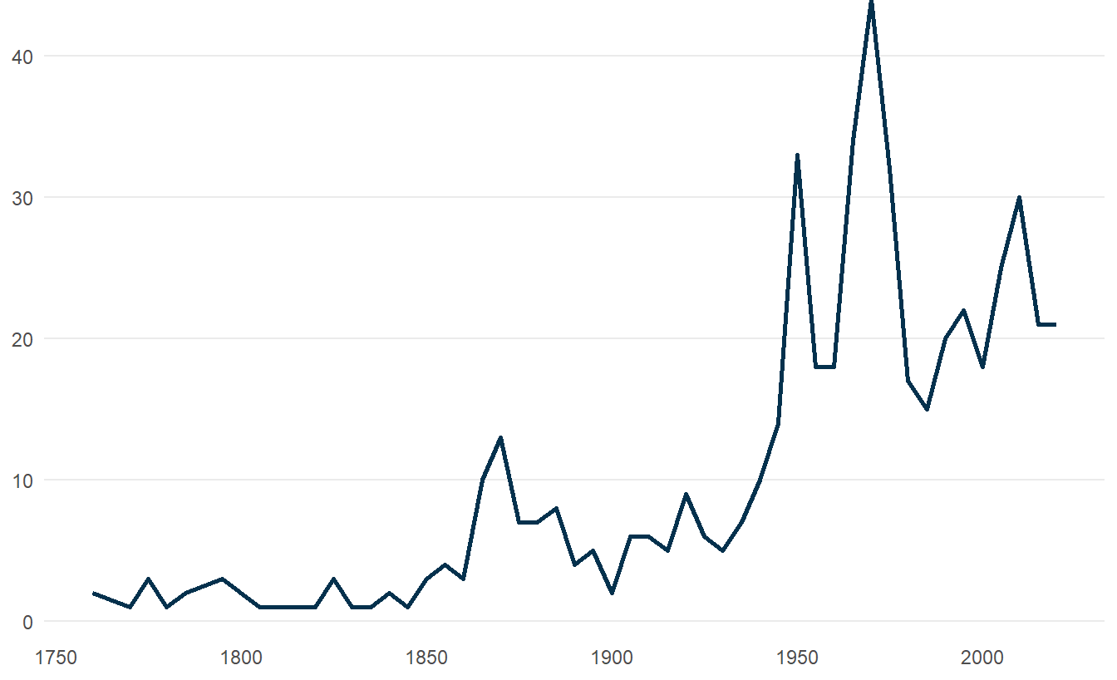
A Stroll through American History
Number of “Firsts” over Time

Slide 4
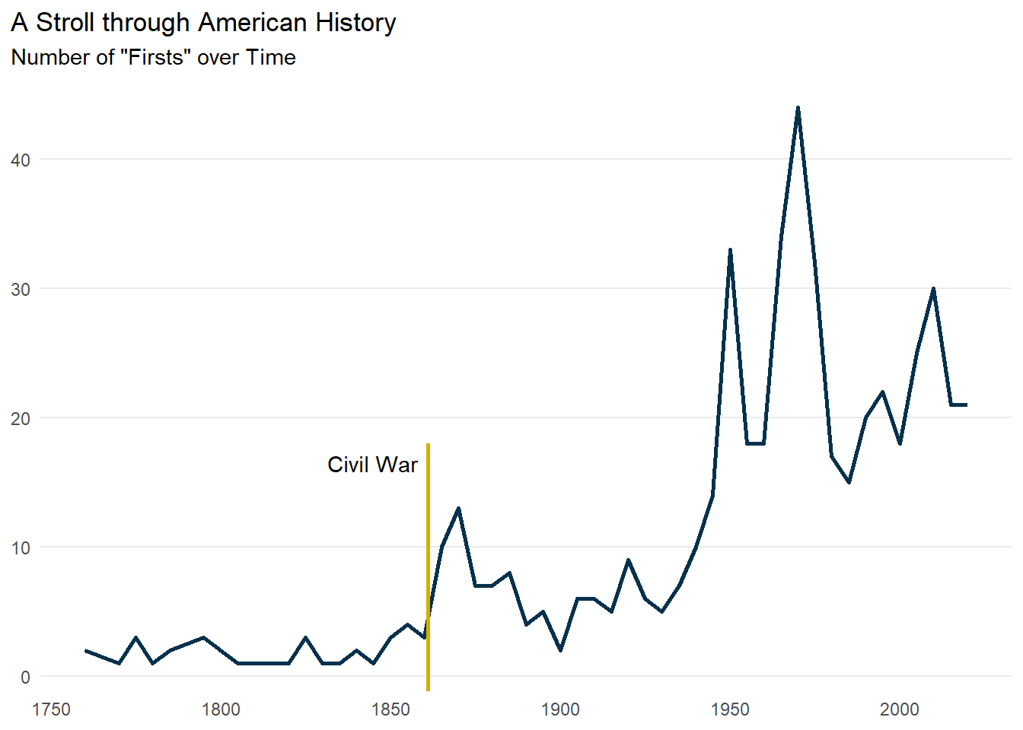
A Stroll through American History
Number of “Firsts” over Time

Slide 5
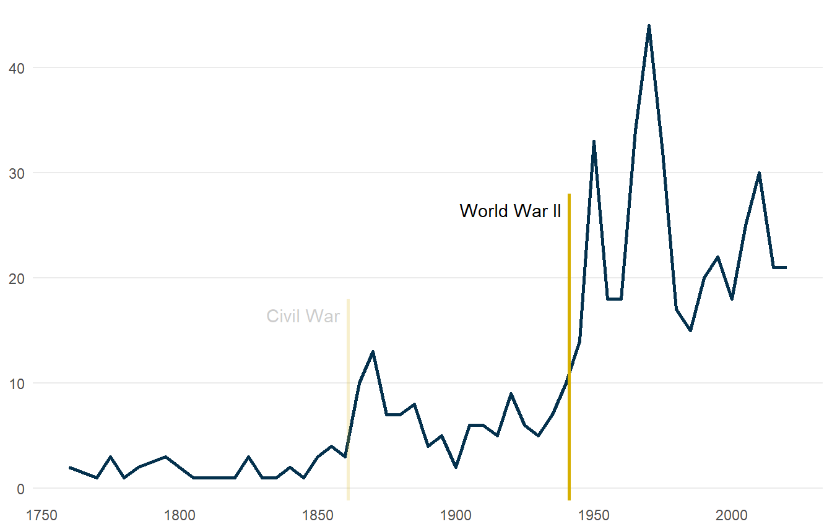
A Stroll through American History
Number of “Firsts” over Time

Slide 6
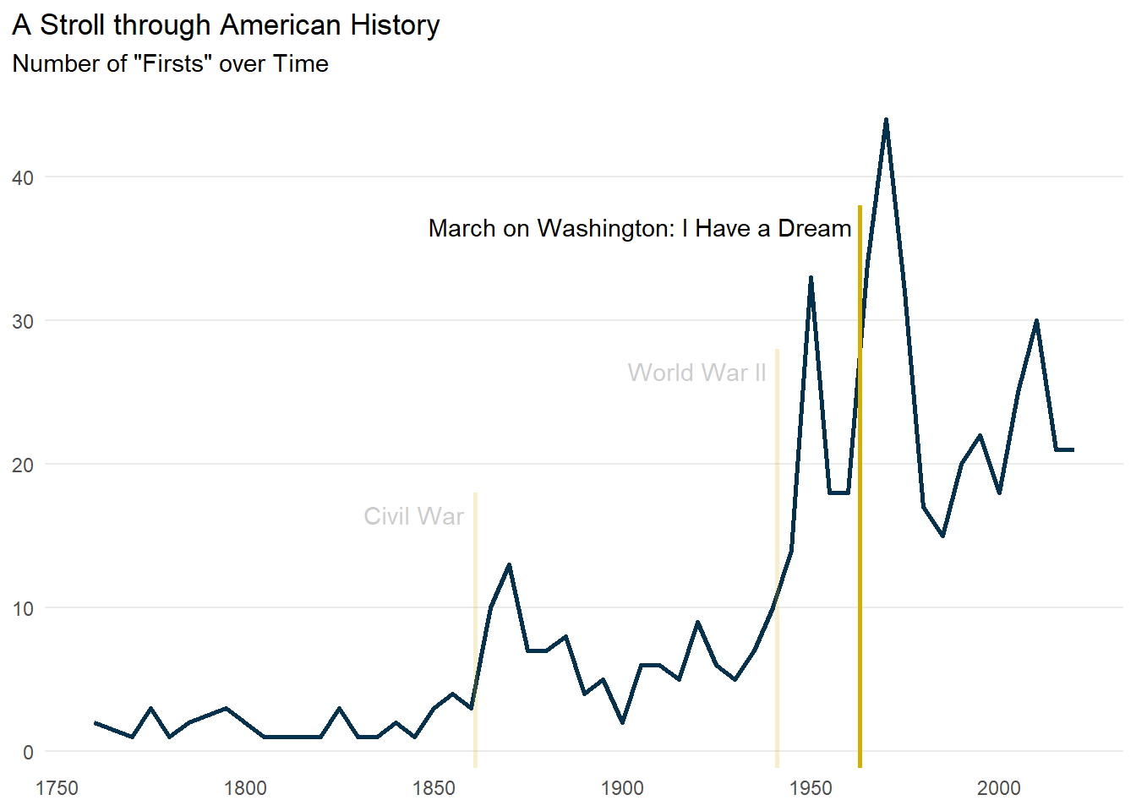
A Stroll through American History
Number of “Firsts” over Time

Slide 7
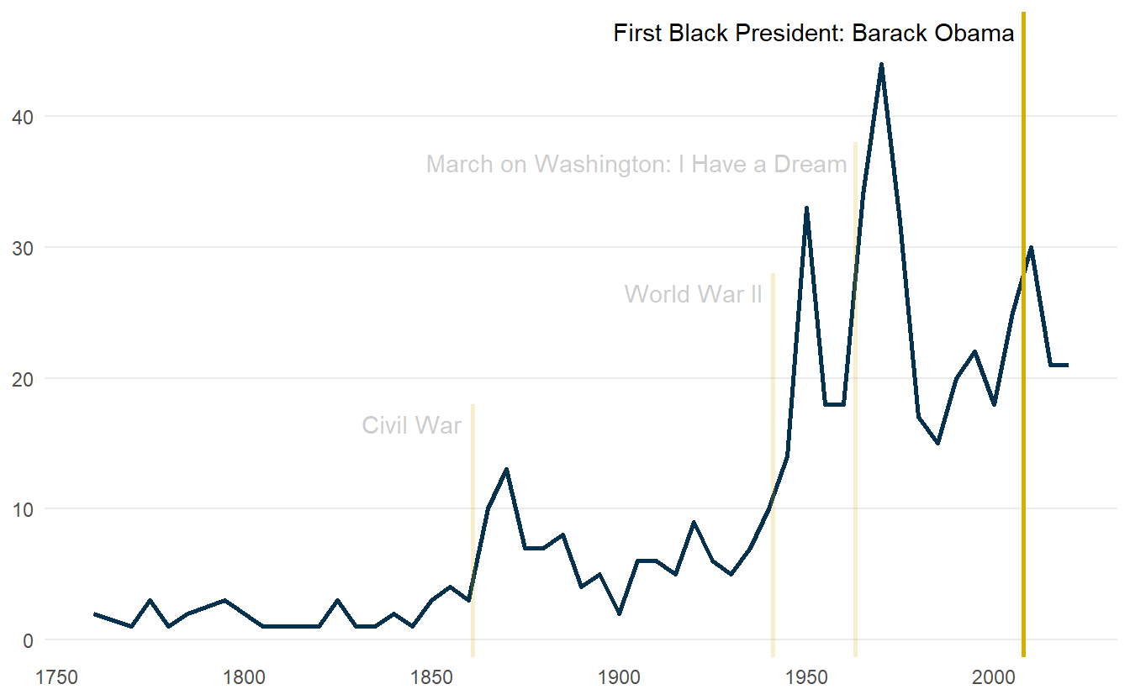
A Stroll through American History
Number of “Firsts” over Time

Slide 8
When will be the next Boost in “Firsts”?
Number of “Firsts” over Time

Slide 9
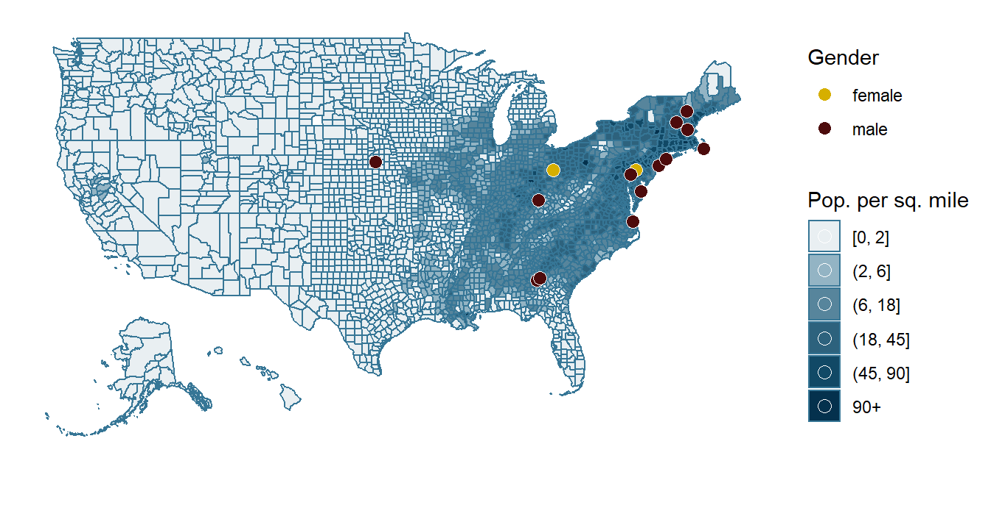
Location of “Firsts” and Population Density
Before 1861
Notes:
Mention black migration to the west has also caused the increase in number of firsts

Slide 10
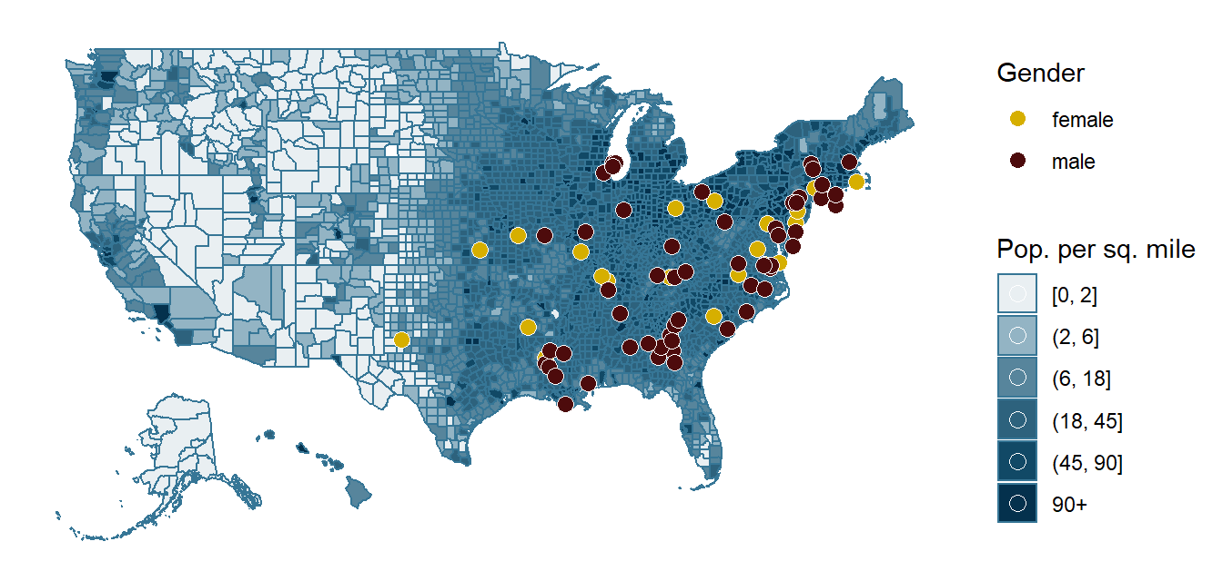
Location of “Firsts” and Population Density
1861 - 1940
Notes:
Mention black migration to the west has also caused the increase in number of firsts

Slide 11
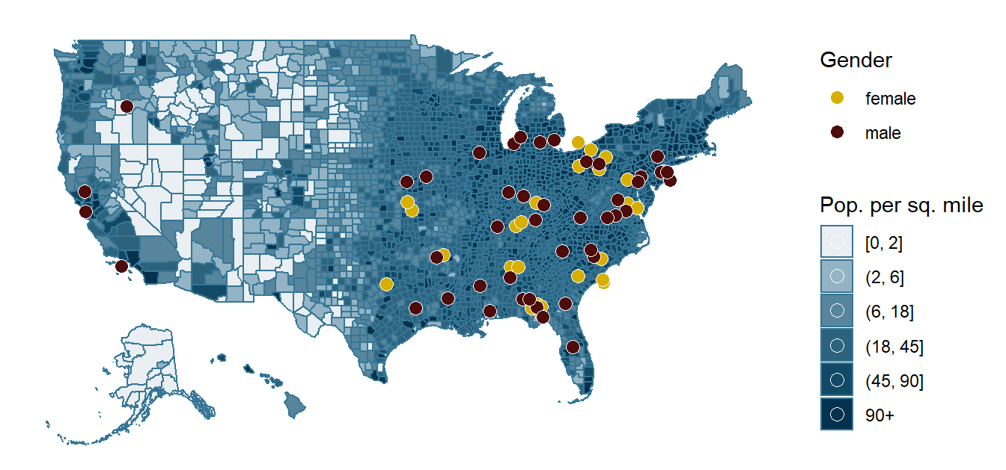
Location of “Firsts” and Population Density
1941 - 1962
Notes:
Mention black migration to the west has also caused the increase in number of firsts

Slide 12
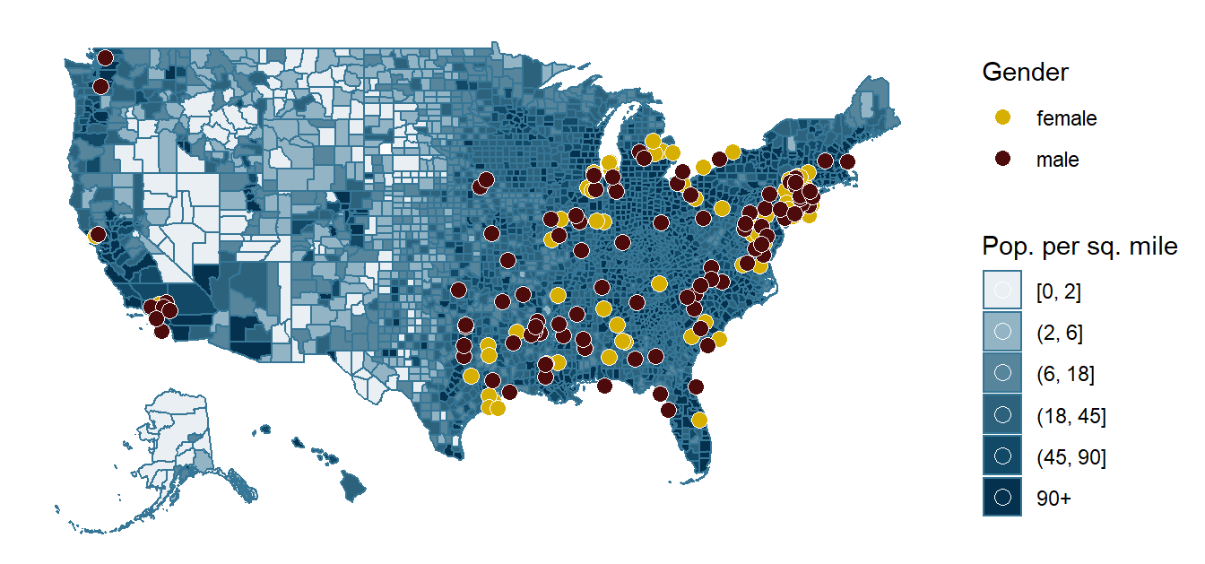
Location of “Firsts” and Population Density
1963 - 2007
Notes:
Mention black migration to the west has also caused the increase in number of firsts

Slide 13
Location of “Firsts” and Population Density
From 2008 onward
Notes:
Mention black migration to the west has also caused the increase in number of firsts

Slide 14
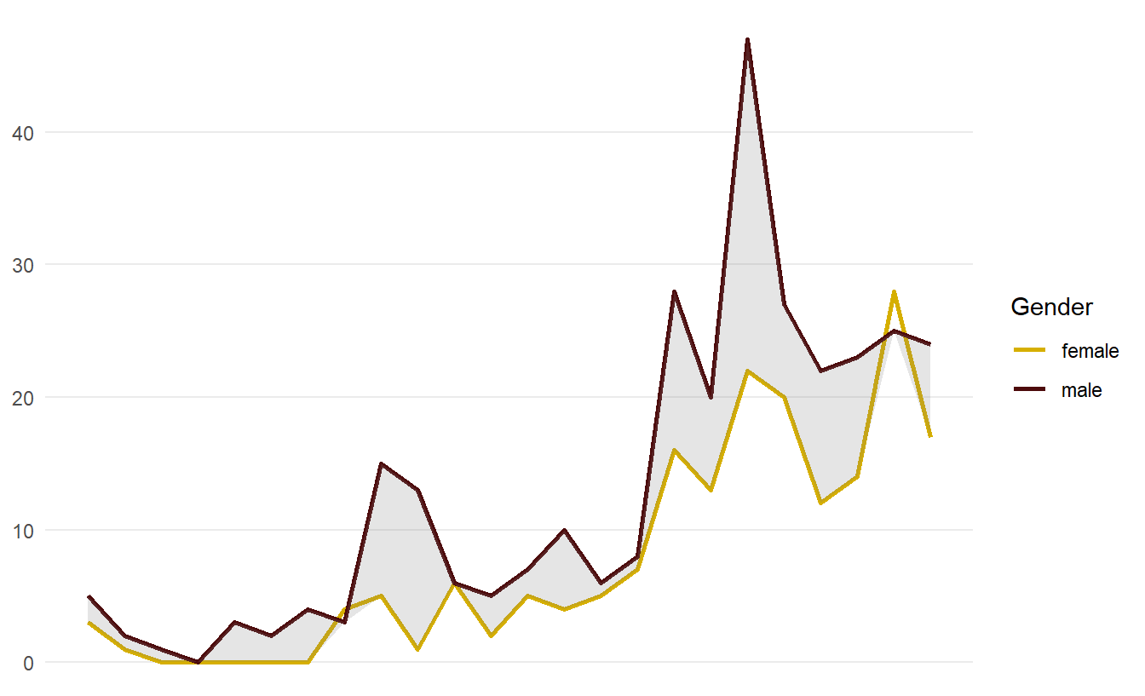
Gender Gap persists over Time
Number of “Firsts” over Time by Gender

Slide 15
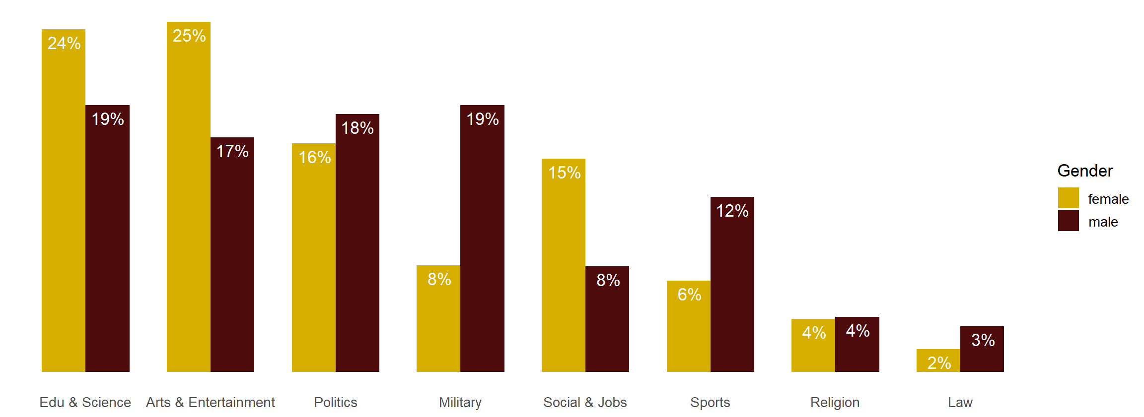
“Firsts” follow stereotypical Gender Roles!
Proportion of “Firsts” per Category by Gender

Slide 16
Limitations
& Discussion
Notes:
DISCUSSIONS AND CRITIQUE

Slide 17
Backup

Slide 18
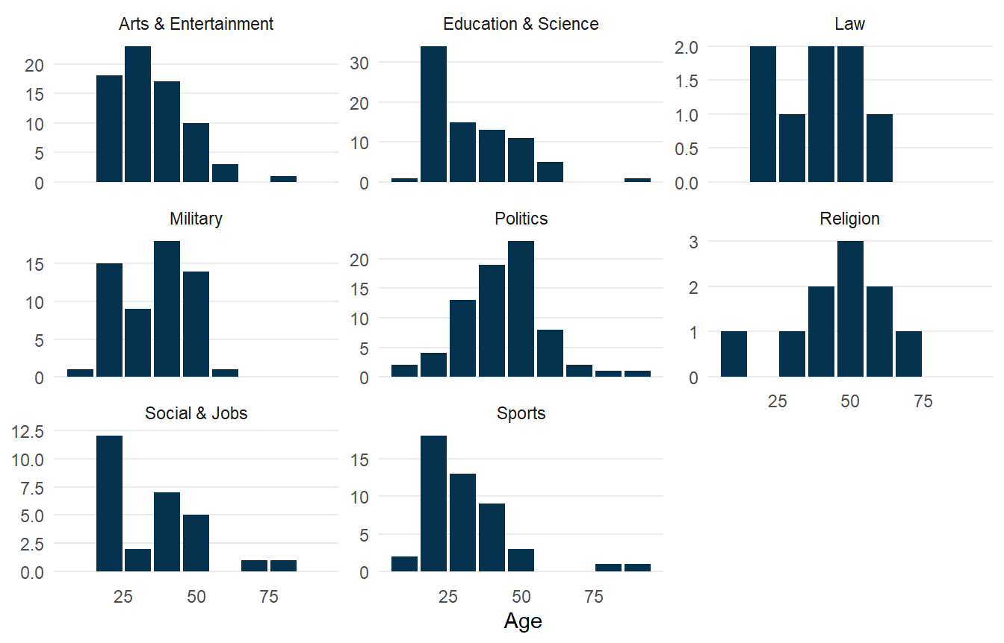
Different “Firsts” with different ages!
Number of “Firsts” by Age and Category

Slide 19
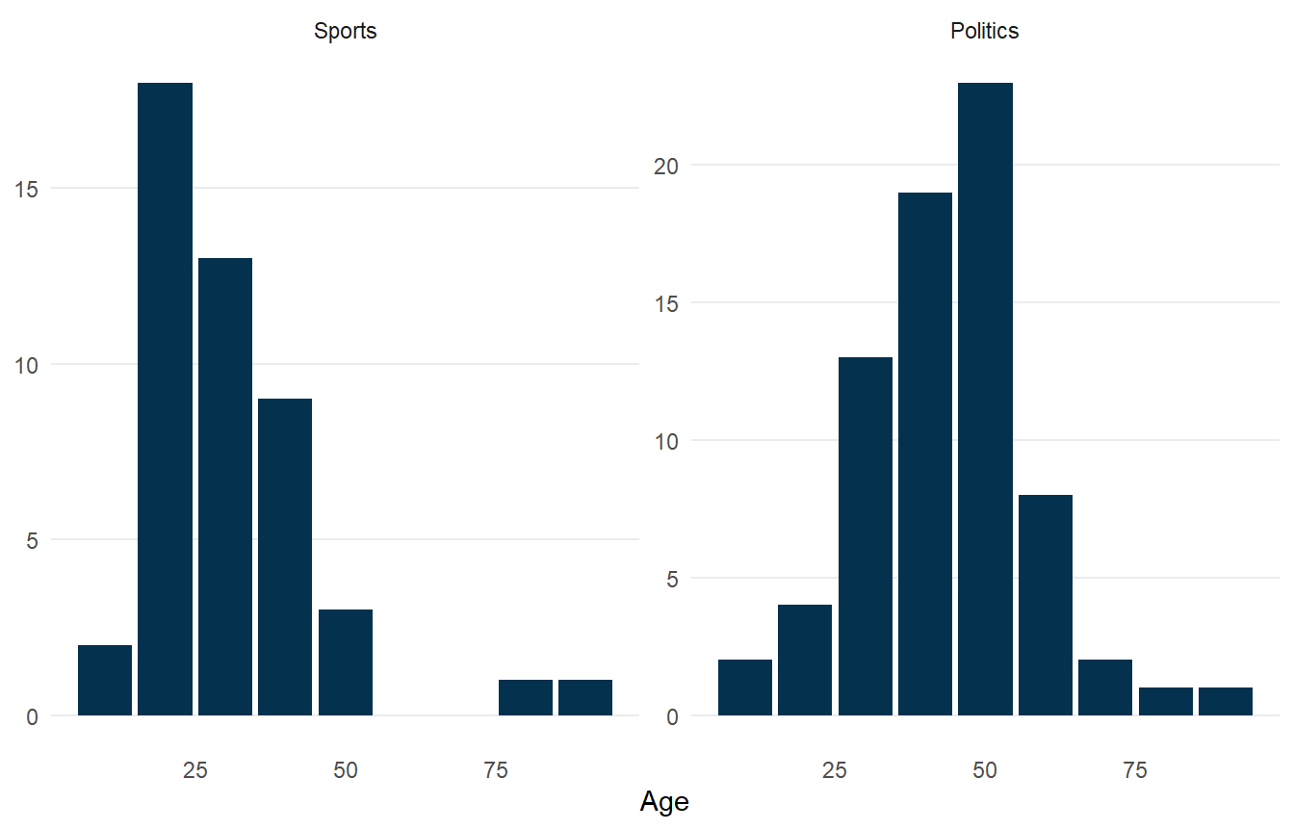
Differences in Sports and Politics
Number of “Firsts” by Age and Category

Slide 20
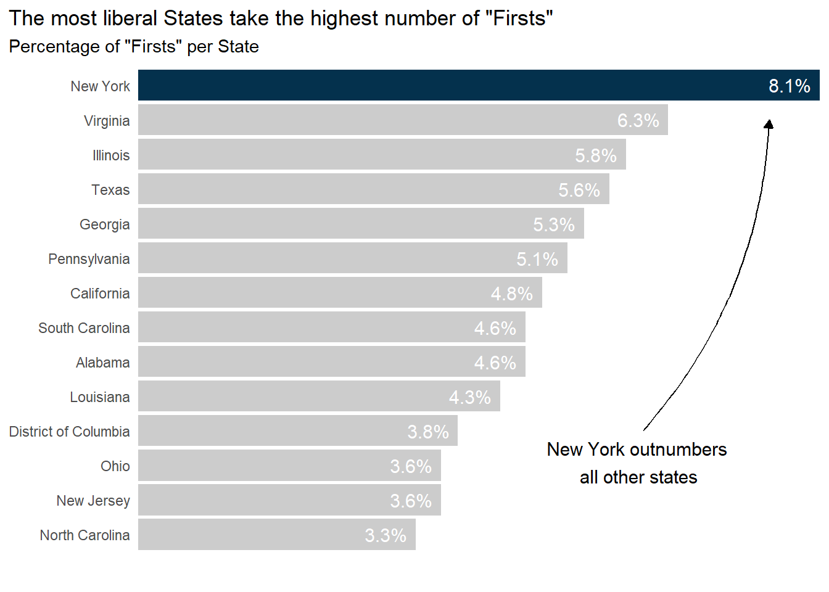
New York has Highest Number of Firsts
Percentage of “Firsts” per State

Slide 21
Thank you! Any Questions?

